Slide 1
Object Oriented Analysis and Design
Introduction

Slide 2
Questions
From user’s point of view, criticize a hardware or software system that has a flaw that especially annoys you. Describe the system, the flaw, how it was overlooked, and how it could have been avoided with a bit more thought during design.
What major problems have you encountered during past software projects? How much time you have spend on analysis, design, coding and testing/debugging/fixing. How do you go about estimating how much effort a project will require?
Recall a past system that you created. Briefly describe it. What obstacles did you encounter in the design? What software engineering methodology, if any, did you use? What were your reasons for choosing or not choosing a methodology? Are you satisfied with the system as it exists? How difficult is it to add new features to the system? Is it maintainable?
Describe a recent large software system that was behind schedule, over budget, or failed to perform as expected. What factors were blamed? How could the failure have been avoided?

Slide 3
System/Software Life Cycle (SLC)
Life cycle is the series of steps that software undergoes from concept exploration through retirement
Intended to develop information systems in a very deliberate, structured and methodical way, reiterating each stage of the life cycle.
Maturity of the process is some gauge of success of organization

Slide 4
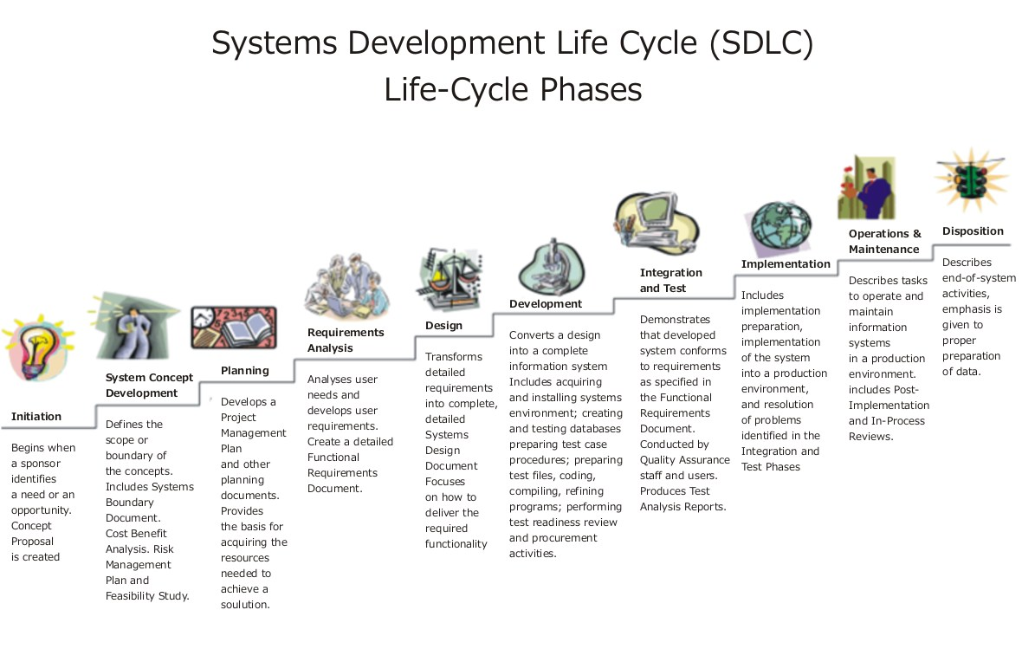
Source: http://upload.wikimedia.org/wikipedia/commons/b/bb/Systems_Development_Life_Cycle.jpg

Slide 5
Importance of Lifecycle Models
Provide guidance for project management
what major tasks should be tackled next? milestones!
what kind of progress has been made?
The necessity of lifecycle models
characteristics of software development has changed
early days: programmers were the primary users
modest designs; potential of software unknown
more complex systems attempted
more features, more sophistication → greater complexity, more chances for error
heterogeneous users

Slide 6
Object Oriented Approach
Software development based on modeling objects from the real world and then use the models to build a language independent design organized around those objects.
Promote better understanding of requirements, cleaner designs, and more maintainable systems.
Use language-independent graphical notation for analyzing problem requirements, design a solution to the problem and then implement the solution.
Same concept and notation throughout the software development process.
Object oriented concepts throughout the software life cycle, from analysis through design to implementation.

Slide 7
Cont.
Coding - last stage in the process of development.
A good design technique defers implementation details until later stages of deign to preserve flexibility.
Mistakes in the front of development process have a large impact on the ultimate product and on the time needed to finish.
OOT is a way of thinking abstractly about a problem using real world concepts, rather than a computer concepts.
Graphical notations helps developer to visualize a problem without prematurely resorting to implementation

Slide 8
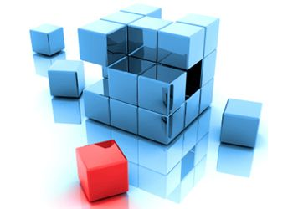
Why Modeling..?

Slide 9
Modeling
A model is a simplification of reality
A hypothetical description of a complex entity or process
A good model includes those elements that have broad effect and omits minor elements
A model of a system is not the system!
Modeling is used in many disciplines – architecture, aircraft building, …

Slide 10
Why Modeling..?
Models help us to visualize a system as it is or as we want it to be.
Models permit us to specify the structure or behavior of a system.
Models give us a template that guides us in constructing a system.
Models document the decisions we have made.

Slide 11
Why Models are needed?
Symptoms of inadequacy: the software crisis
scheduled time and cost exceeded
user expectations not met
poor quality

Slide 12
Build and Fix Model

Slide 13
Waterfall Model
a systematic, sequential approach to software development that begins at the system level and progresses through analysis, design, coding, testing, and support
Requirements
Phase
Requirements
Description
Specification
Phase
Specification,
SPMP
Design
Phase
Design Docs
Verify
output of stages
Verify
output of stages
Implementation
& Integration
Phase
Flaw?
Flaw?
Product
original model didn’t
let you go back!
original model didn’t
let you go back!
Operations
Mode
Retirement
Notes:
The major flaw with the original model is that it didn’t support iteration…
what if there was an incompleteness, contradiction, or ambiguity in the specification?

Slide 14
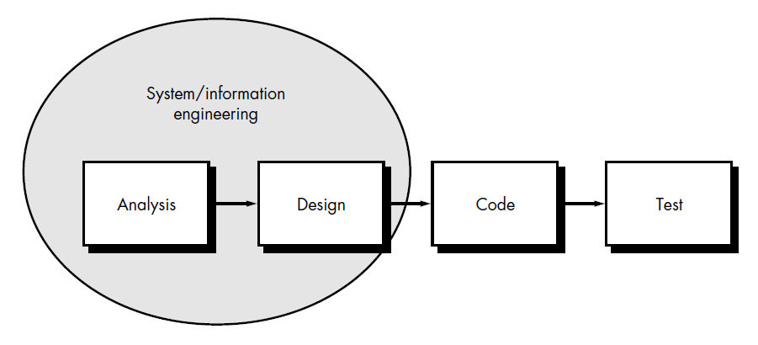
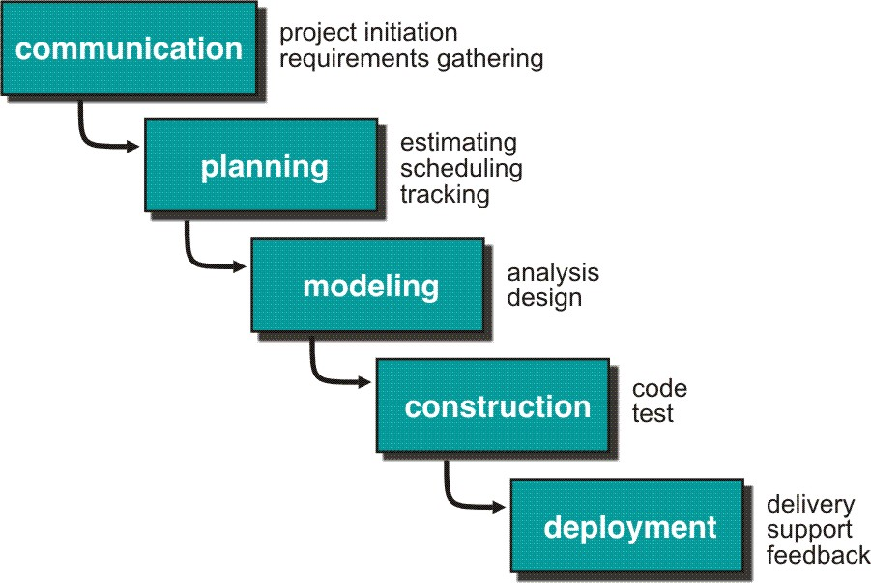

Slide 15
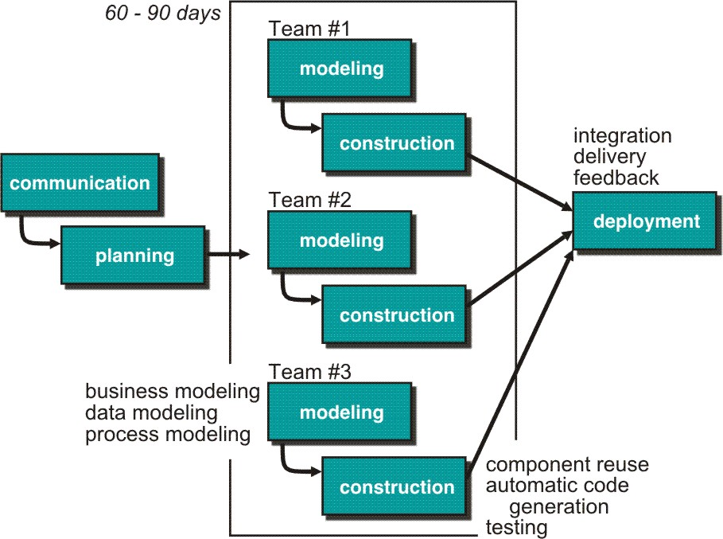
Rapid Application Development (RAD) Model
Makes heavy use of reusable software components with an extremely short development cycle

Slide 16
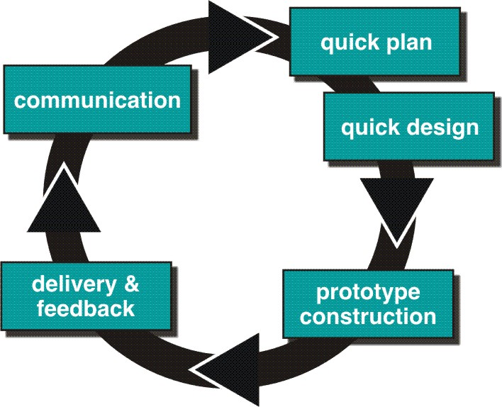
Prototype Model

Slide 17
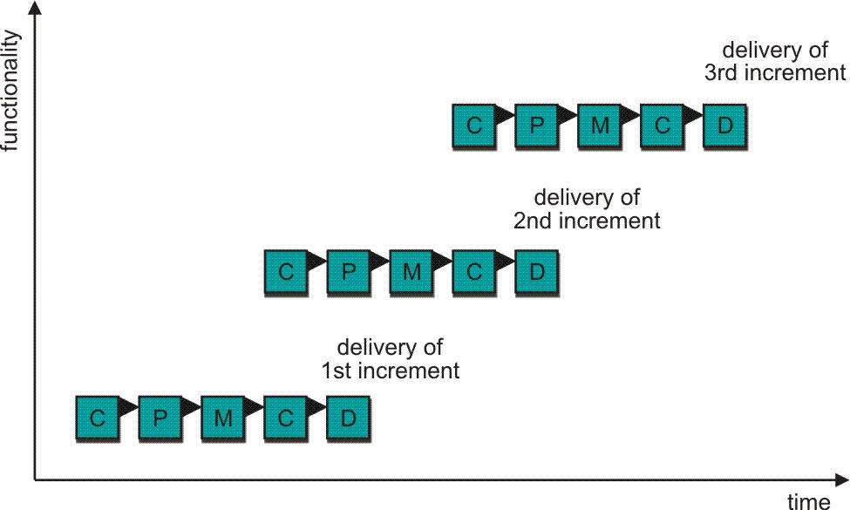
Incremental Model
(combines elements of the linear sequential model (applied repetitively) with the iterative philosophy of prototyping)
C- Communication
P - Planning
M – Modeling
C - Construction
D - Deployment
Delivers software in small but usable pieces, each piece builds on pieces already delivered

Slide 18
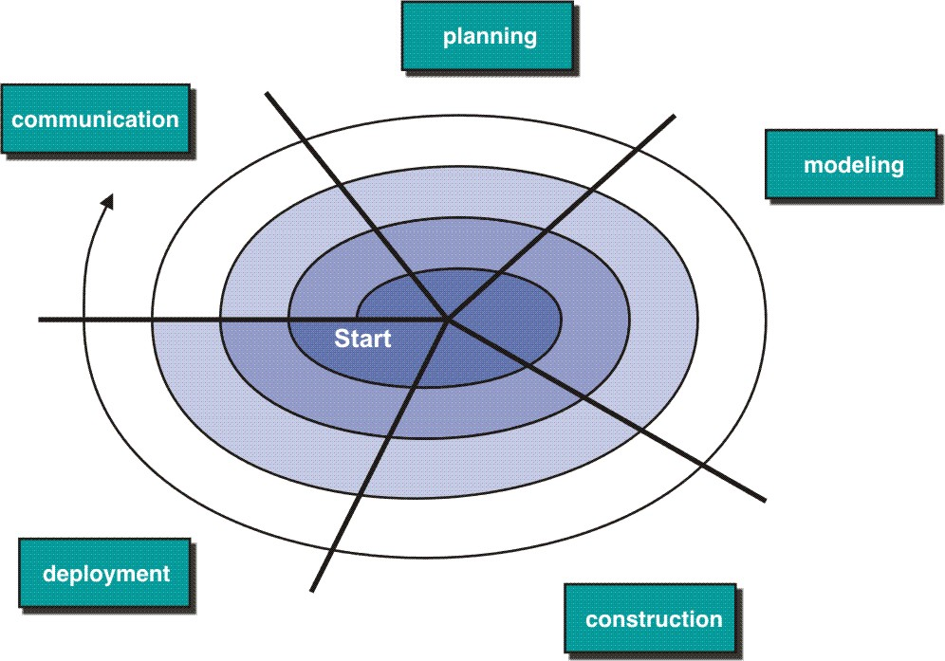
Spiral Model

Slide 19
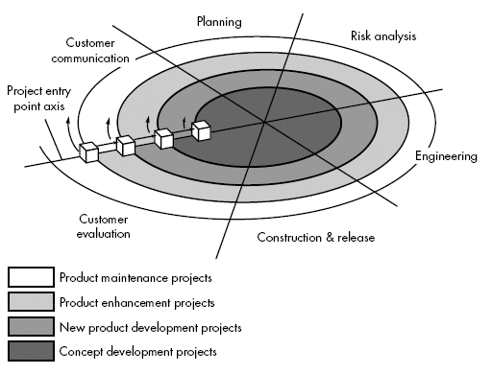
Spiral Model

Slide 20
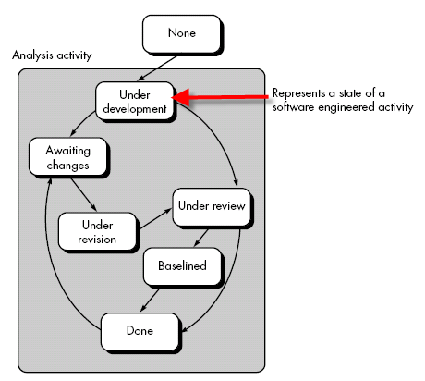
Concurrent Development Model

Slide 21
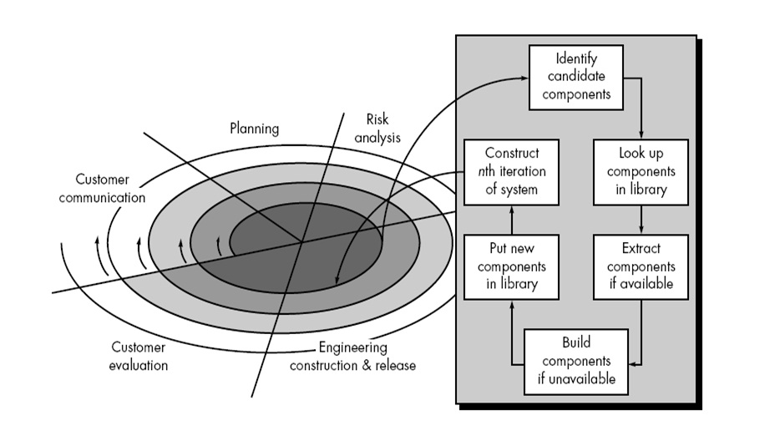
CBD Model

Slide 22
The difference between procedural and object-oriented analysis….??

Slide 23
Object-Oriented Vs Traditional analysis
Traditional procedural systems separate data and procedures, and model these separately
Object orientation –views data and functions together; data abstraction is the basis
OO view more closely reflects the real world where humans are used to think in terms of things which possess both attributes and behaviors.
OO provides reuse possibility from the class hierarchy views of the system.
OO analysis centers on objects which combines data and methods.
Software extensibility is easy.

Slide 24
Object-orientation : Four important aspects
Identity
Classification
Polymorphism or Encapsulation and
Inheritance.

Slide 25
Contd..
Identity
data is quantized into discrete, distinguishable entities called “objects”.
Each object has its own inherent identity
Classifications
objects with the same data structure (attributes) and behavior (operations) are grouped into a class.
A class is an abstraction that describes properties important to an application and ignores the rest

Slide 26
Inheritance
is sharing of attributes and operations among classes based on a hierarchical relationship.
A superclass has general information that subclasses refine and elaborate
Subclasses need not repeat features of its superclass and add its own unique features
The ability to factor out common features of several classes into a superclass can greatly reduce repetition within designs and programs and is one of the main advantages of OO technology
Polymorphism
means that the same operation may behave differently for different classes.
Operation and method???

Slide 27
Importance of Objects
The single most important principle of object oriented computing is that "objects are responsible for their own actions".
If used properly, OOD improves the maintenance, reusability, and modifiability of the software.

Slide 28
The Basic Principles of Object Orientation
Four basic principles:
Abstraction
Encapsulation
Modularity
Hierarchy

Slide 29
Abstraction
An abstraction denotes the essential characteristics of an object that distinguish it from all other kinds of objects and thus provide crisply defined conceptual boundaries, relative to the perspective of the viewer.
Key concepts:
Concentrating only on essential characteristics
Allows complexity to be more easily managed
Abstraction is relative to the perspective of the viewer
Many different views of the same object are possible.

Slide 30
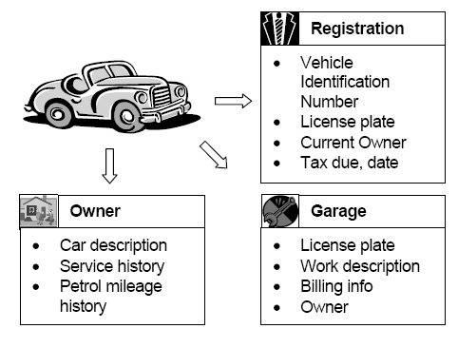

Slide 31

Encapsulation
Encapsulation is the practice of including in an object everything it needs hidden from other objects. The internal state is usually not accessible by other objects.
Key concepts:
Packaging structure and behavior together in one unit
Makes objects more independent
Objects exhibit an interface through which others can interact with it
Hides complexity from an object’s clients

Slide 32
Modularity
Modularity is the property of a system that has been
decomposed into a set of cohesive and loosely coupled
modules.
Module: a collection of related classes of objects
Key concepts:
Modules are cohesive (performing a single type of tasks)
Makes modules more reusable
Modules are loosely coupled (highly independent)
Makes modules more robust and maintainable

Slide 33
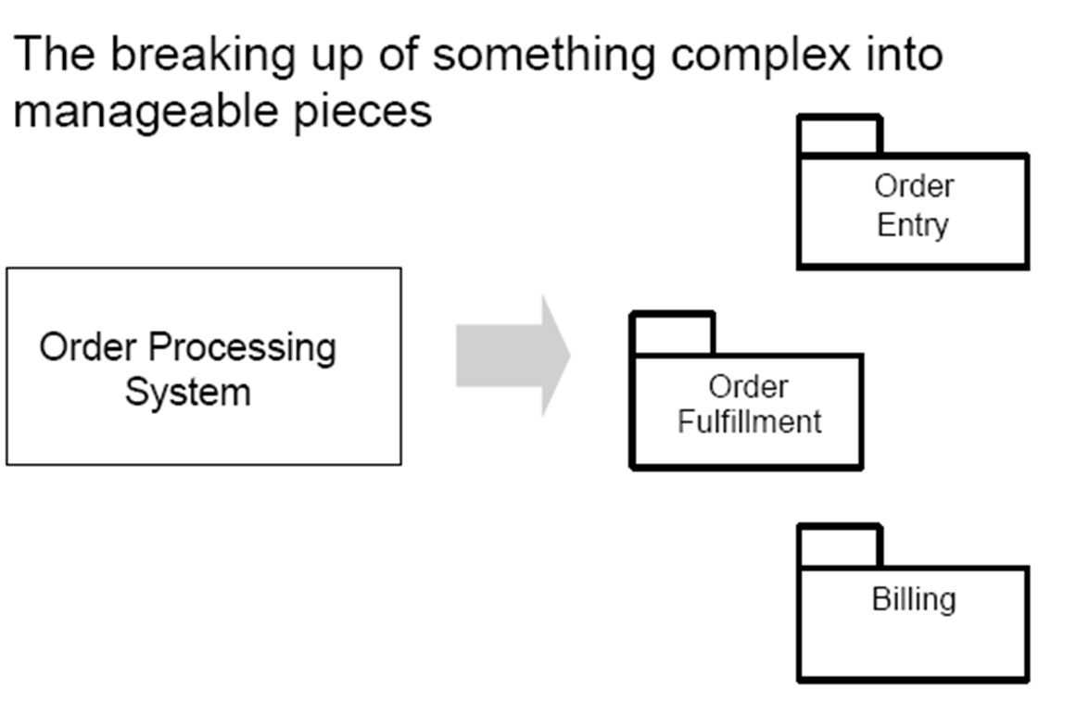

Slide 34
Hierarchy
Hierarchy is a ranking or ordering of abstractions
OR
Organizing things into different levels of abstraction
Types of hierarchies:
Class
Aggregation
Containment
Inheritance
Partition
Specialization

Slide 35
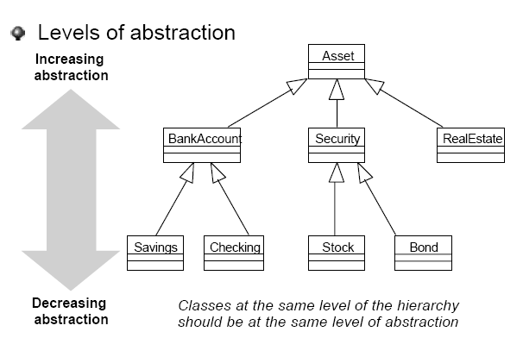
Example: Hierarchy

Slide 36
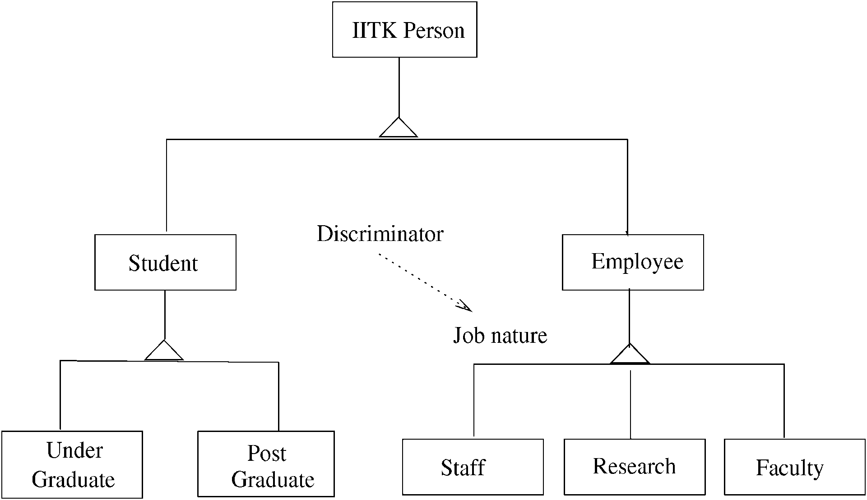
Example: Class hierarchy

Slide 37
Basic Concepts of Object Orientation
Object
Class
Attribute
Operation
Component
Package

Slide 38
Object
An object represents an individual, identifiable item, unit, or entity, either real or abstract, with a well-defined role in the problem domain.
Or
An "object" is anything to which a concept applies.
Also, object is an instance of a class
An object can be
A physical entity (car, fan, man, etc)
A conceptual entity (A chemical process)
A software entity (stack, queue, linked list)

Slide 39
Objects have the following qualities:
Identity: Objects are distinguishable from one another
Behavior: Objects can perform tasks
State: Objects store information that can vary over time

Slide 40
Class
A class is a blueprint that describes an object and defines attributes and operations for the object
Classes use abstraction to make available only the elements essential to defining the object
Classes use encapsulation to enforce an abstraction
Simple terms: It is a collection of objects

Slide 41
Relations between Objects and Classes
A class is an abstract definition of an object
It defines the structure and behavior of each object in the class
It serves as a template for creating the objects
Objects are grouped into classes

Slide 42
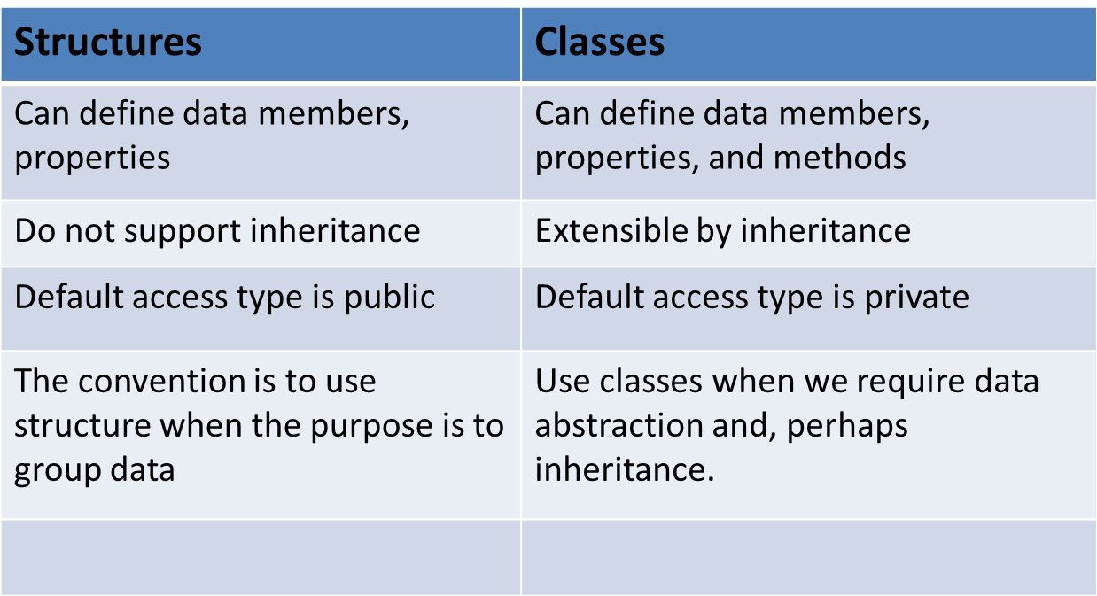
Difference between Structures and Classes

Slide 43
Attributes:
It describes the state (data) of an object
Operation:
Define its behavior
What an object is capable of doing

Slide 44
Component:
A non-trivial, nearly independent and replaceable part of a system that fulfills a clear function in the context of a well defined architecture.
A component may be
A source code component
A run time component
An executable component

Slide 45
Package:
A package is a general purpose mechanism for organizing elements into groups.
A model element which can contain other model elements.

Slide 46
Strengths of Object Orientation:
Facilitates architectural and code reuse
Models more closely reflect the real world
More accurately describe corporate data and processes
Decomposed based on natural partitioning
Easier to understand and maintain
Stability
A small change in requirements does not mean massive changes in the system under development

Slide 47
Analysis
Analysis - investigation of the problem.
What does the system do?
Requirements Analysis is discovering the requirements that a system must meet in order to be successful.
Object Analysis is investigating the object in a domain to discover information important to meet the requirements.

Slide 48
Requirements Analysis
One of the basic principles of good design is to defer decisions as long as possible.
The more you know before you make a design decision, the more likely it will be that the decision is a good one.
TFCL: Think First, Code Later!

Slide 49
Design
Design emphasizes a conceptual solution that fulfills the requirements.
How a system is to be built?
A design is not an implementation, although a good design can be implemented when it is complete.
There are subsets of design, including architectural design, object design, and database design.

Slide 50
Analysis Vs Design
Analysis
Focus on understanding the problem
(Generalized) Behavior
Separation of Concerns
System structure
Functional requirements
Some recognition for non-functional requirements
A small model
Design
Focus on understanding the solution
Operations and Attributes
Performance, Efficiency…
Close to real code
Object lifecycles
Non-functional requirements in detail
A large model

Slide 51
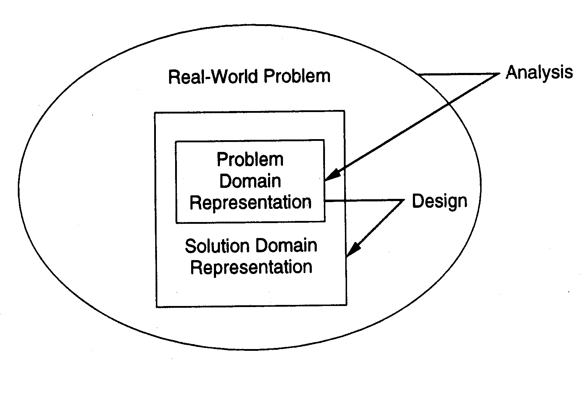

Slide 52
Goal of Analysis
Understand the problem; try to build a visual model of what you are trying to do independent of implementation or technology concerns.
Focus on translating the functional requirements into software concepts

Slide 53
Goal of Design
OOD enables a software engineer to
Indicate the objects that are derived from each class
How these objects interrelate with one another
OOD depicts how
Relationships among objects are achieved
Behavior is to be implemented
Communication among objects is to be implemented

Slide 54
OO analysis and design
Essence of OO analysis –
consider a problem domain from the perspective of objects (real world things, concepts)
Ex: In a Library Management System, some of the concepts
include Book, Library, and Patron.
Essence of OO design –
define the solution as a collection of software objects (allocating responsibilities to objects)
Ex: In a Library Management System, a Book software object may
have a title attribute and a getChapter method.
Book
______
title
getChapter()

Slide 55
The End

Slide 56
Coupling
Coupling is an inter-module concept, captures the strength of interconnection between modules
More tightly coupled the modules, the more they depend on each other, more difficult to modify one
Low coupling is desirable for making systems understandable and modifiable
In OO, three types of coupling exists – interaction, component, and inheritance

Slide 57
Coupling…
Interaction coupling occurs due to methods of a class invoking methods of other classes
Like calling of functions
Worst form if methods directly access internal parts of other methods
Still bad if methods directly manipulate variables of other classes
Passing information through temporary variables is also bad

Slide 58
Coupling…
Least interaction coupling if methods communicate directly with parameters
With least number of parameters
With least amount of information being passed
With only data being passed
I.e. methods should pass the least amount of data, with least number of parameters

Slide 59
Coupling…
Component coupling – when a class A has variables of another class C
A has instance variables of C
A has some parameters of type C
A has a method with a local variable of type C
When A is coupled with C, it is coupled with all subclasses of C as well
Component coupling will generally imply the presence of interaction coupling also

Slide 60
Coupling…
Inheritance coupling – two classes are coupled if one is a subclass of other
Worst form – when subclass modifies a signature of a method or deletes a method
Coupling is bad even when same signature but a changed implementation
Least, when subclass only adds instance variables and methods but does not modify any

Slide 61
Cohesion
Cohesion is an intra-module concept
Focuses on why elements are together
Only elements tightly related should exist together in a module
This gives a module clear abstraction and makes it easier to understand
Higher cohesion leads to lower coupling – many interacting elements are in the module
Goal is to have higher cohesion in modules
Three types of cohesion in OO – method, class, and inheritance

Slide 62
Cohesion…
Method cohesion – why different code elements are together in a method (like cohesion in functional modules)
Highest form is if each method implements a clearly defined function with all elements contributing to implementing this function
Should be able to state what the module does by a simple statement

Slide 63
Cohesion…
Class cohesion – why different attributes and methods are together in a class
A class should represent a single concept with all elements contributing towards it
Whenever multiple concepts encapsulated, cohesion is not as high
A symptom of multiple concepts – different groups of methods accessing different subsets of attributes

Slide 64
Cohesion…
Inheritance cohesion – focuses on why classes are together in a hierarchy
Two reasons for subclassing
generalization-specialization
reuse
Cohesion is higher if the hierarchy is for providing generalization-specialization

